Slide 2
Smart City Foundations: The Engineering Information Maturity Model
DAVID VANDERSCHEE
President North America, RedEye Apps Inc.

Slide 3
THE CHALLENGE: Managing Legacy Engineering Information
District Energy operations and maintenance relies on engineering information – drawings, controlled documents, 3D models – and the processes that manage and maintain them.
Traditionally, these have been managed manually:
Reliance on experienced staff
Silos of information
Changes communicated in-person
Modern conditions are changing this dynamic:
Knowledge Transfer: experienced staff are leaving, and taking knowledge of accurate engineering information with them
Security: engineering information is a critical security risk, that is often as risk of exploitation ie: how secure is an emailed drawing?
Access: as campuses digitize, it’s imperative that this information be made available to all stakeholders, both internatl and external

Slide 4
THE CHALLENGE: What To Focus On? Where To Start?
RedEye works closely with many asset-owning organizations, and has observed that the biggest challenge with engineering information management is ‘getting started’:
Some campuses are focusing on BIM (without having accurate foundational information)
Some just want clean records (without the processes to keep it clean)
Others are happy with the status quo (without appreciating the risk and cost to their business)

Slide 5
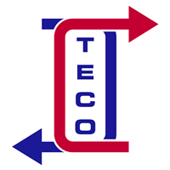
CONSIDER A TYPICAL DISTRICT ENERGY PROVIDER: Thermal Energy Corporation (TECO)
TECO is the sole provider of chilling, heating and emergency power services for the Texas Medical Center (TMC) in Houston.
Like any modern District Energy organization, TECO are experiencing many challenges:
Multiple contractors managing different projects and activities
Staffing constraints
COVID policies preventing information sharing
Risks and opportunities from digitization
As a critical infrastructure operator, they have tens of thousands of files of engineering information on file – engineering drawings, controlled documents, and manuals.
Should it be required, any one of these pieces of information could be critical to continued operation of their infrastructure, and the ongoing supply to TMC.
Texas Medical Center, the largest medical facility in the world

Slide 6
ESTABLISHING A PATH FORWARD: The Engineering Information Maturity Model
After observing the same challenges across many of our partners, RedEye embarked on a project to standardize how districts could not only ascertain the current state of their engineering information, but also establish a path forward.
The result was the Engineering Information Maturity Model, designed specifically to support organizations with this overlooked aspect of their Smart Cities journey:
Assessing the current state of engineering information,
Quantifying operational risk, and
Producing a tailored roadmap to improvement.
Assess The Current State
Quantify Risk
Roadmap To Improvement

Slide 7
THE MATURITY MODEL: 5 Levels Of Information Maturity
Each Level reflects the effectiveness and value to the District of each category of Information Management
LEVEL 5
Best in Class / Optimized
PERFORMING
LEVEL 4
Efficient: Mature Critical Controlled Information Management / Control
LEVEL 3
Mature Informational Control (Initial Critical Controlled Management)
ASSESSING THE STAGE OF DEVELOPMENT
NORMING
LEVEL 2
Established Initial Control
FORMING
STOMRING
LEVEL 1
Initial Engineering Information Management (Minimum Required)

Slide 8
THE MATURITY MODEL: Defining Success At Each Level
Success with Information Management is achieved when, broadly, the following tollgates are met
Level 5: Best in Class / Optimized – A world class RIM and Doc Control Team which has full adoption and stakeholder alignment/buy-in. All core processes are consistent and continuously improved, all key project data is collected, analytics are comprehensive, and reporting is completely data driven. Systems are integrated and various data, along with related metadata, are easily accessible, accurate and tracked. Quality Assurance for Doc Control handover is 98%.
Level 4: Efficient / Grown-up – A very successful RIM Function which has good sponsorship. All core processes are consistent, all stakeholders are educated on Records Classification and Retention. Document Control Plays an important role in the success of Operations, Engineering and Projects with the use of consistent review cycles for all critical controlled documents. Vendor/Project DC work with the Central DC Team for successful handover. Legal hold, reviews and audit are easily automated.
Level 3: Mature/Managed – A solid RIM function which experiences more successes than failures. Most processes have consistency, records are classified, retained and there is a documented disposition process while Document Control is getting standardized, has a numbering standard and documents have a review cycle. Critical Controlled Documents become defined.
Level 2: Established / Repeatable – A recognized RIM function is operating but needs improvement. Some processes have consistency, records are classified, stored and retained. Document Control has the first stages of an ecosystem but no standards
Level 1: Immature / Initial – A RIM entity is operating but with inconsistent processes, non-standard classification structures, no retention schedules and no document control ecosystem
Level 0: Absent – No identifiable RIM or Doc Control Principles, Standards or Processes

Slide 9
THE MATURITY MODEL: Level 1 – Identification And Classification
The default for most Districts – a basic knowledge of engineering information, with minimal control
Identification of Engineering Information:
Identify: Define what is classes as “Engineering Information” and assign basic “classification” designation
First and basic step is to define and differentiate between works-in-progress (future records) and actual records (evidence of operational and/or transactional activity, point-in-time evidence). These range from hiring documents to receipts. Generally, all business decisions, plans, activities, organizational structures and strategies will fall into this category.
Level 5:
Best In Class
Level 4:
Efficient / Grown-Up
Level 3:
Mature / Managed
ACCESS
AUDIT
DISPOSE/ARCHIVE
Level 2:
Established / Repeatable
IDENTIFY
CAPTURE
1
2
2
2
3
Level 1:
Immature / Initial

Slide 10
THE MATURITY MODEL: Level 2 – Capturing Metadata
Metadata = corporate knowledge critical to ongoing success
Controlled Engineering Information is “evergreen” or ”live”. Each version is a record (snapshot) while the current version should reflect the current planned or existing process, standard, procedure and/or facility it is referencing. Having a Level 1 “engineering information management” standard is an essential building block and works as a prerequisite to enable and facilitate true EIM control.
Capture: Level 2 requires the capturing of basic/primary metadata fields: document type, published date (date of record), retention classification
Access: Besides basic user access to a system, Level 2 gets more granular and will have access logs of all records, these will be used for audit. Access requests will include a justification
Audit: Auditing will include a QA of metadata, review of access controls and access logs (who has access and who has accessed) Foundational information for legal hold
Level 5:
Best In Class
Level 4:
Efficient / Grown-Up
Level 3:
Mature / Managed
ACCESS
AUDIT
DISPOSE/ARCHIVE
Level 2:
Established / Repeatable
IDENTIFY
CAPTURE
1
2
2
2
3
Level 1:
Immature / Initial

Slide 11
THE MATURITY MODEL: Level 3 – Criticality And Control
Effective management of business critical engineering information
Critical Controlled Documents (CCDs) are a Level 3 capability and have some of the highest “severity” and/or “criticality” ratings associated to engineering information within an organization. A Level 2 Document Control standard is a prerequisite for consistent and accurate CCD management. The only difference between “controlled documents” and “critical controlled documents” is the attribution, captured via metadata, to the record. Copies of predecessors are recorded, changes are captured along with change purposes/reasons and a list of everyone involved in the change and review/approval of that change, including the document controller.
Older versions are either layered or archived for the purpose of making inaccessible to anyone needing the current version but available for audit reviews when required.
Dispose/Archive: Archival of old, superseded or inactive records with a documented disposition process that “tickets” (logs) all records disposed of, whether physical or digital, showcasing that they were disposed of in the “normal course of business” and had “matured” to meet their regulatory and business retention dates per the classification and associated retention schedule.
*This document classification will usually be found referenced in business continuity plans and emergency response plans.
Level 5:
Best In Class
Level 4:
Efficient / Grown-Up
Level 3:
Mature / Managed
Level 2:
Established / Repeatable
DISPOSE/ARCHIVE
ACCESS
AUDIT
IDENTIFY
CAPTURE
1
2
2
2
3
Level 1:
Immature / Initial

Slide 12
THE MATURITY MODEL: Level 4 – Process Consistency
Ensuring that your ‘Live’ Engineering Information is updated concurrently with your infrastructure
Level 5:
Best In Class
This reflects a very successful organizational function, with good oversight and sponsorship.
Processes: all core processes are consistent in Level 4, with all stakeholders are educated on access, control, and management.
Management: Document Control plays an important role in the success of Operations, Engineering and Projects with the use of consistent review cycles for all critical controlled documents.
Vendor Engagement: external third parties are integrated into your Engineering Information Management.Legal hold, reviews and audit are easily automated.
Level 4:
Efficient / Grown-Up
Level 3:
Mature / Managed
Level 2:
Established / Repeatable
Level 1:
Immature / Initial

Slide 13
THE MATURITY MODEL: Level 5 – Best In Class
Thought-leader in Engineering Information Management
Level 5:
Best In Class
A world class team has full adoption, stakeholder alignment, and oversight of your engineering information.
All core processes are consistent and continuously improved, all key project data is collected, analytics are comprehensive, and reporting is completely data driven.
Systems are integrated and various data, along with related metadata, are easily accessible, accurate and tracked.
Quality Assurance for Doc Control handover is greater than 98%.
Level 4:
Efficient / Grown-Up
Level 3:
Mature / Managed
Level 2:
Established / Repeatable
Level 1:
Immature / Initial

Slide 14
ASSESSING YOUR MATURITY: How To Deploy The Model @ Your District?
Each District is unique, managing their engineering information as necessary for their circumstances.
It is critical to focus on the focus areas of engineering information management that are relevant to you
The RedEye recommended ‘default’ focus areas can be seen on the following page
Consider the following when assessing your Maturity:
Different teams will have different opinions. External contractors can often provide good honest feedback
Be honest with your current state
Consider processes, standards, storage, and access.

Slide 15
ASSESSING YOUR MATURITY: The Assessment Summary
Score Yourself On Your Top 10 Engineering Information Activities
Level 5
Level 5
Level 5
Level 5
Level 5
Level 5
Level 5
Level 5
Level 5
Level 5
Level 4
Level 4
Level 4
Level 4
Level 4
Level 4
Level 4
Level 4
Level 4
Level 4
Level 3
Level 3
Level 3
Level 3
Level 3
Level 3
Level 3
Level 3
Level 3
Level 3
Level 2
Level 2
Level 2
Level 2
Level 2
Level 2
Level 2
Level 2
Level 2
Level 2
Level 1
Level 1
Level 1
Level 1
Level 1
Level 1
Level 1
Level 1
Level 1
Level 1
Version Control
Criticality
Records Classification and Retention Schedules
Review Cycle (CCD)
Transmittals
Redline Markups
Access / Controls
Access / Storage
Concurrent Engineering
Audit (Internal / External)

Slide 16
REDEYE @ TECO: Why TECO Chose RedEye
When TECO chose to partner with RedEye, we were able to collaboratively improve against their key focus areas, as identified in our assessment, such as:
Version Control: ensuring users could reference a Single Source of Truth, rather than digging through multiple versions
Auditability: improving cybersecurity of their engineering information, and understanding who was accessing what
Accessibility: field access, and inviting in external parties, was seen as an opportunity for improvement
As an Engineering Data Management Solution (EDMS), the RedEye platform was able to offer a single solution to TECO, providing:
Process consistency across the District
Reduce reliance on individuals
Improve security around drawing and document management, in perpetuity

Slide 17
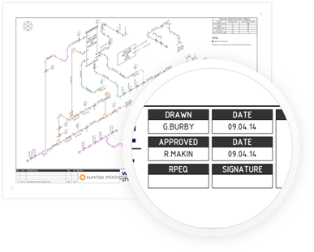
REDEYE @ TECO: How TECO Adopted RedEye
+
MIGRATED RECORDS AND DOCUMENTS FROM LEGACY LOCATIONS
“INVITED PEOPLE IN” TO VIEW and USE THEIR INFORMATION
Consolidated drawings, documents and data from silos across TECO
Eliminated commercial barriers to enhance internal and external collaboration
Eliminated duplicates
Extracted Metadata using advanced Optical Character Recognition (OCR)

Slide 18
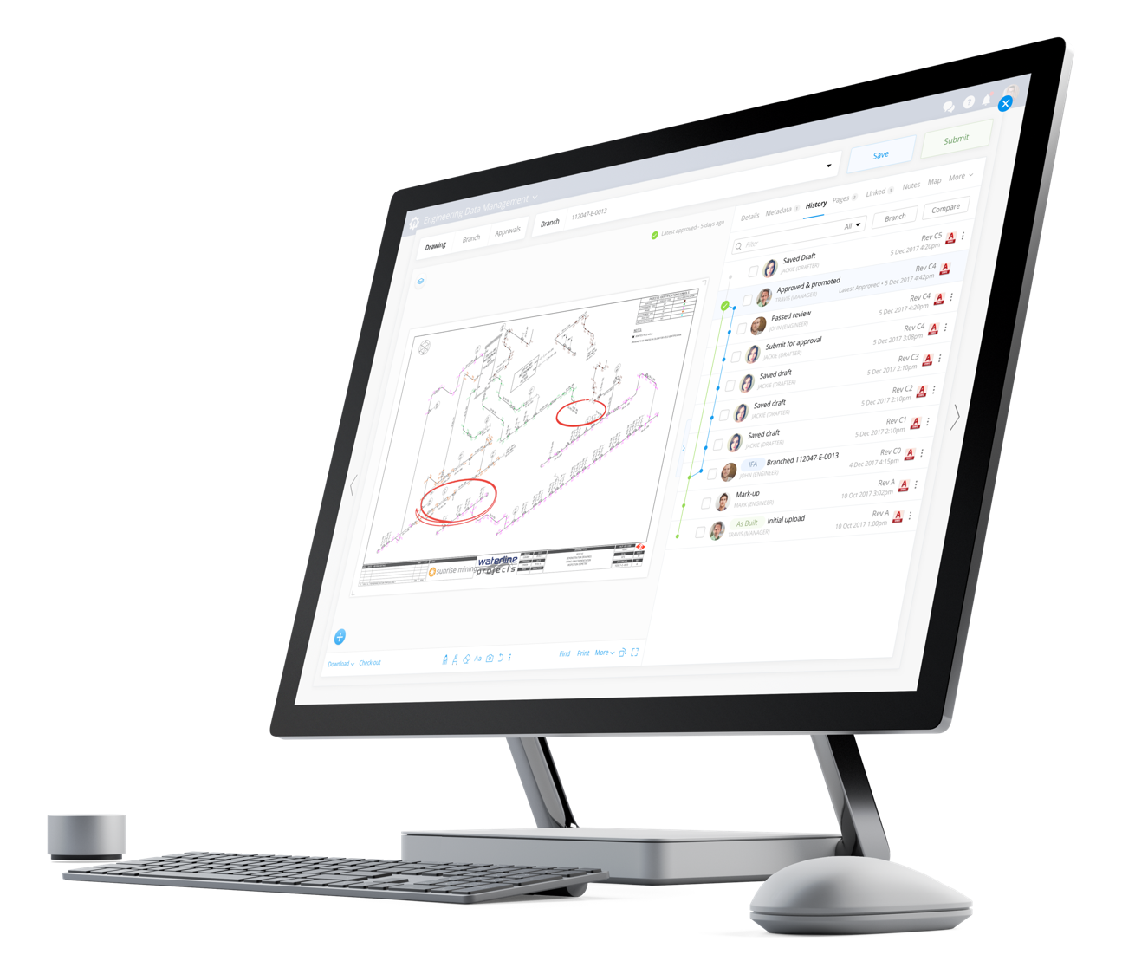
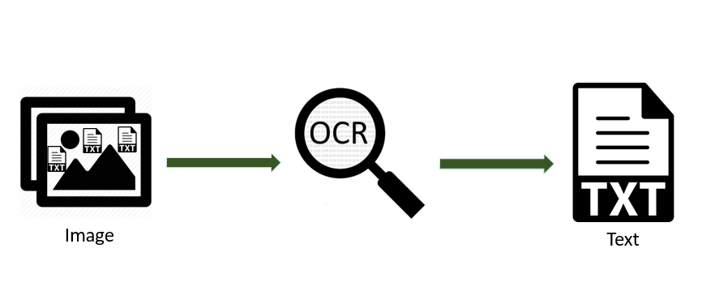
REDEYE @ TECO: How TECO Is Benefiting From RedEye
Search made easy anywhere, anytime
Total version control and auditability
view all revisions in a single digital timeline
“Google-esque” search with intuitive user interface
Markup / Review / Approve
Map search
Quick migration from existing platform to RedEye
Virtualized folders
QR Codes to control printed copies and group files
Fully mobile platform – iOS, Android, Web
350-1500 files upload and OCR per minute
View and manage extensive and advanced file types (2D, 3D, Media etc) … no need for source
software
Our REST API allows integration with any system

Slide 19
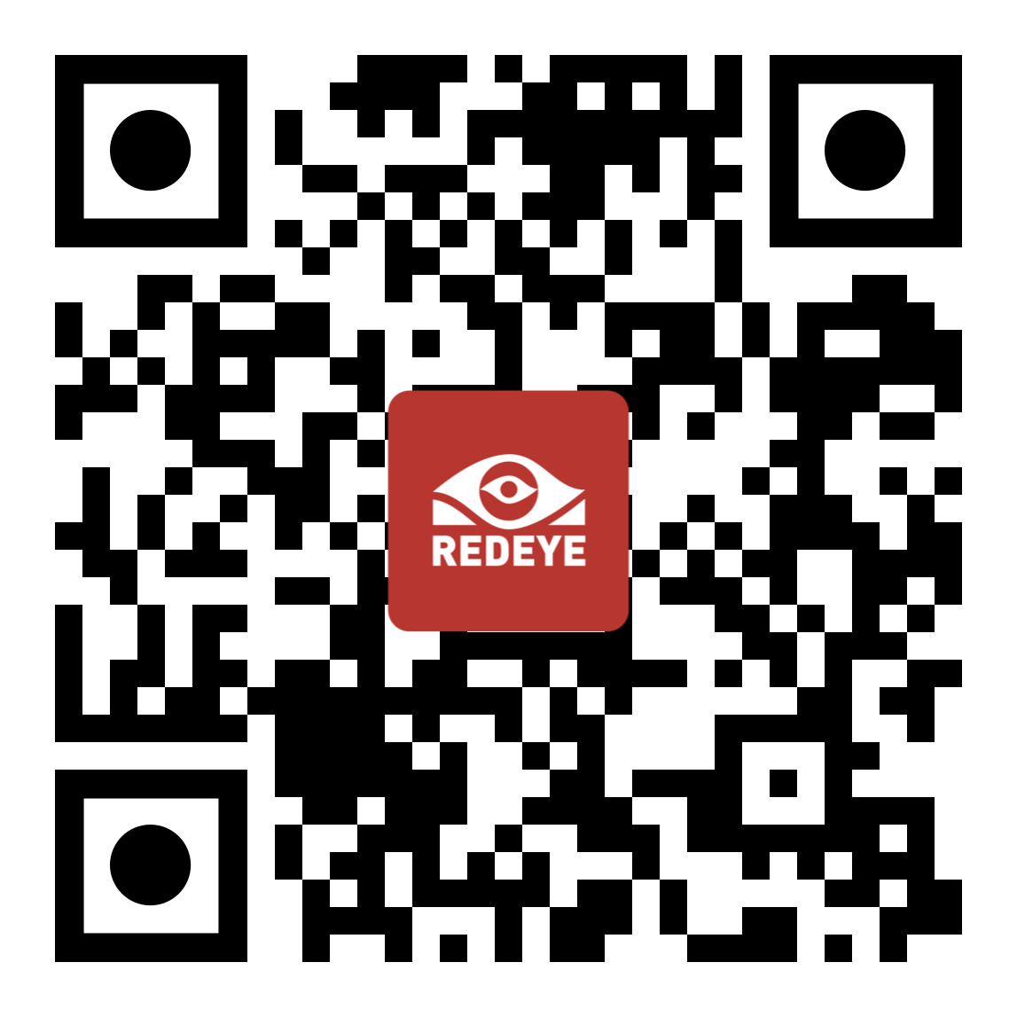
TOOLKIT ITEMS TO TAKE BACK TO YOUR DISTRICTS: Recommended Next Steps
RedEye is providing the following resources exclusively to attendees!
Engineering Information Survey This is an excellent starting point to any changes at your District
Digital Engineering Standard This will be a useful reference when looking at standardization of engineering drawings and models across your organization
The RedEye team can answer any questions you have on either of these resources – contact us to learn more.

Slide 20
Q&A

Slide 21
Thank You!
David VanderSchee
President, North America
RedEye Apps Inc
EMAIL
david.vanderschee@redeye.co
PHONE
O: (833) REDEYE1 (733-3931)
C: (203) 727-0679
Website
https://www.redeye.co/

