Slide 2
Staying Connected to Asset Health TRACK, DRIVE & ACHIEVE YOUR NET ZERO GOALS
Ken Daycock

Slide 3
Achieve What You Measure
Asset Health, like Human Health Requires:
Data
Accurate Data (Big Data)
Multiple Data Sources
Various Technologies
Analytics
Ability to Tracking, Trend & Report
Anomaly Detection
Diagnostics
Prognostics
Forecasting
Energy
Temperatures
Pressures
Flows
Emissions
Efficiency
Sampling
Energy Sources
Inspection
UT
Thermography
People
Temperatures
B/P
Weight
EKG/ECG
CBC
CT Scan
MRI
X-Ray
Biopsy
Examination

Slide 4
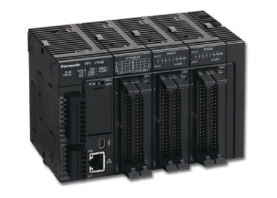
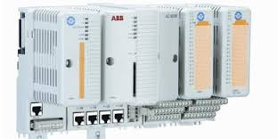
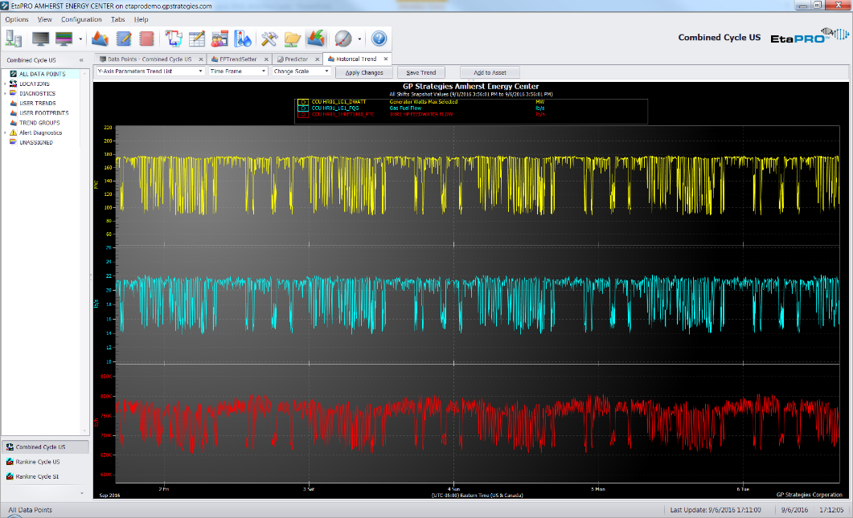
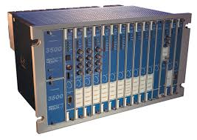
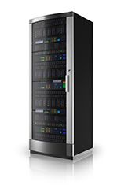
Process DATA MANAGEMENT
Data Sources

Slide 5
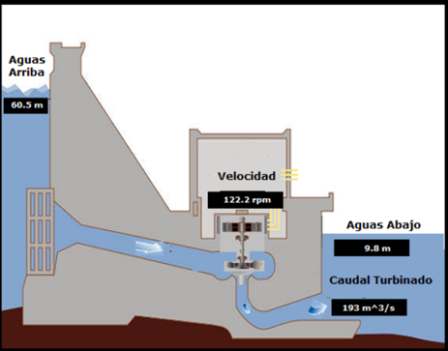
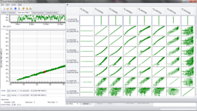
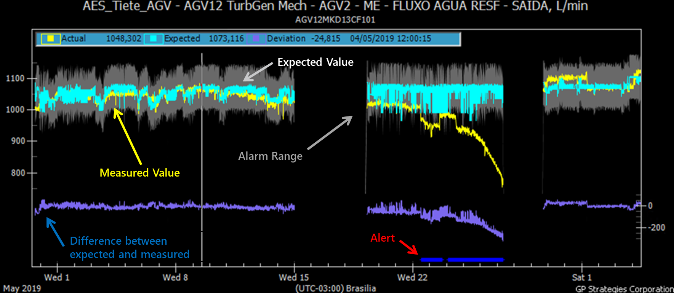
Anomaly Detection (Empirical TWIN)
Sensors
APR Model
Power Output
Reactive Load
Gate Position
Voltage
Current
Flows
Stator Temps
Bearing Vibration
Identified a drop in thrust bearing outlet cooling flow on one of the six hydro units. Faulty valve identified as causing flow drop off.

Slide 6
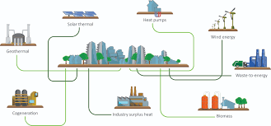
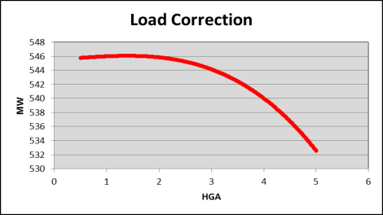
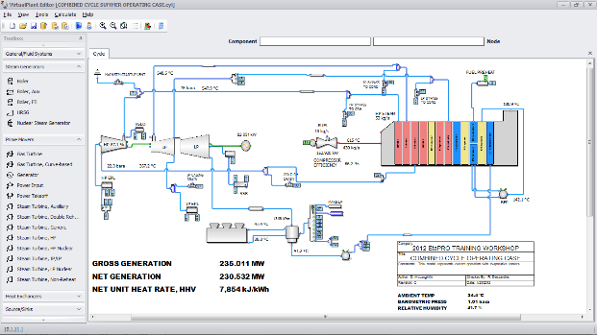
Thermodynamic Model (Physics-based TWIN)
Design Data
Engineering Principles
Steam Generator
Turbines
Heaters
Condenser
Cooling
Pumps
Power Inputs
Power Users
Emissions

Slide 7
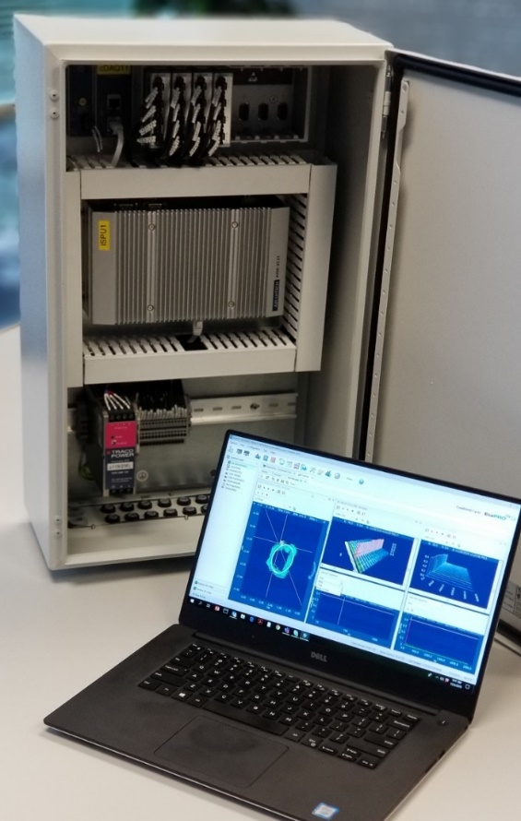
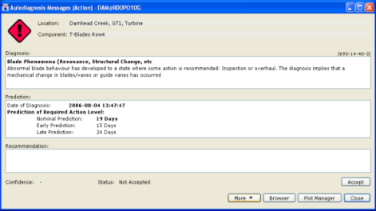
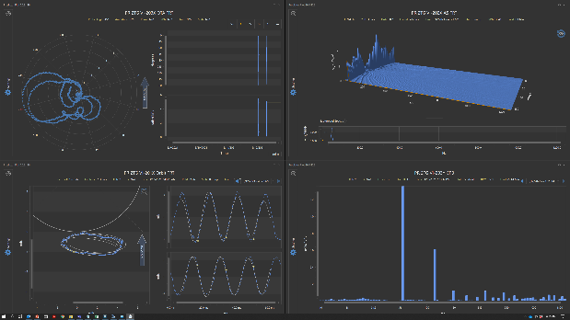
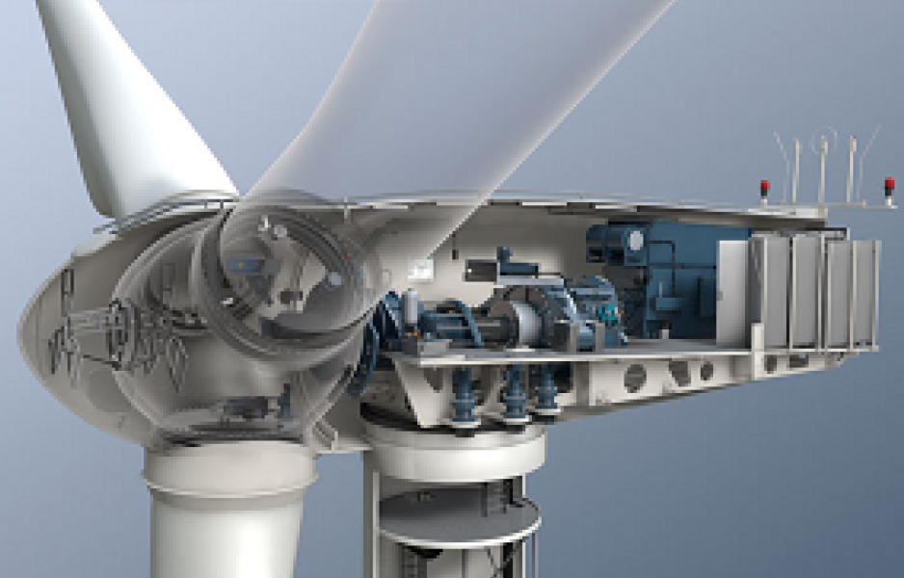
Machinery Dynamics (Frequency domain)
Vibration Signature History
AutoDiagnosis™

Slide 8
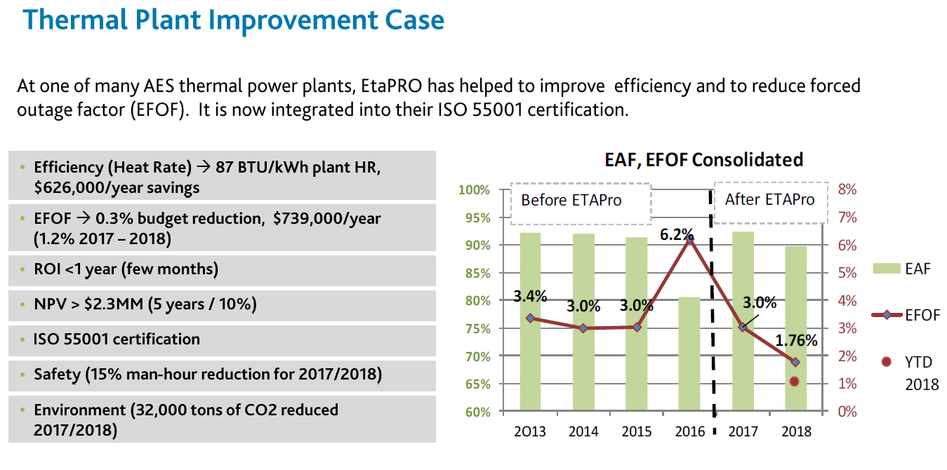
Representative Case Study

Slide 9
Platform Demonstration

Slide 10
Lessons Learned and Best Practices
District Energy systems are complex, expansive and diverse. Having a fully integrated real-time platform makes it possible to balance off-sets, monitor efficient operations and ensure reliable delivery of critical services.
Digital Twins provide the ability to forecast and perform What-If scenarios, in support of real-time and day-ahead dispatching.
Digital Twins can also be used for evaluating process and technology changes needed to meet emissions expectations.
Advanced data driven tools for machinery diagnostics and anomaly detection are essential for ensuring the availability and reliability of CHP assets.

Slide 11
Q&A
?

Slide 12
Thank You!
Ken Daycock
Business Development Manager
Ken.Daycock@EtaPRO.com
716-766-1958

