Slide 2
Integrating Renewable Energy & Greenhouse Gas Reduction
Jeremy Smith, P.E.

Slide 3
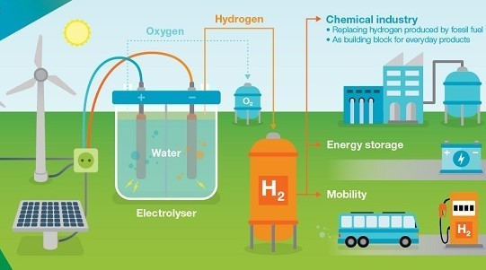
Hydrogen as the Answer
Hydrogen
Can be generated with all electric or small footprint CO2 with steam-methane-reformer technology
Can reduce greenhouse gas emissions when deployed in the field with renewables (PV, wind, renewable gas)
Significant regulatory and safety concerns, relating mostly to lack of education

Slide 4
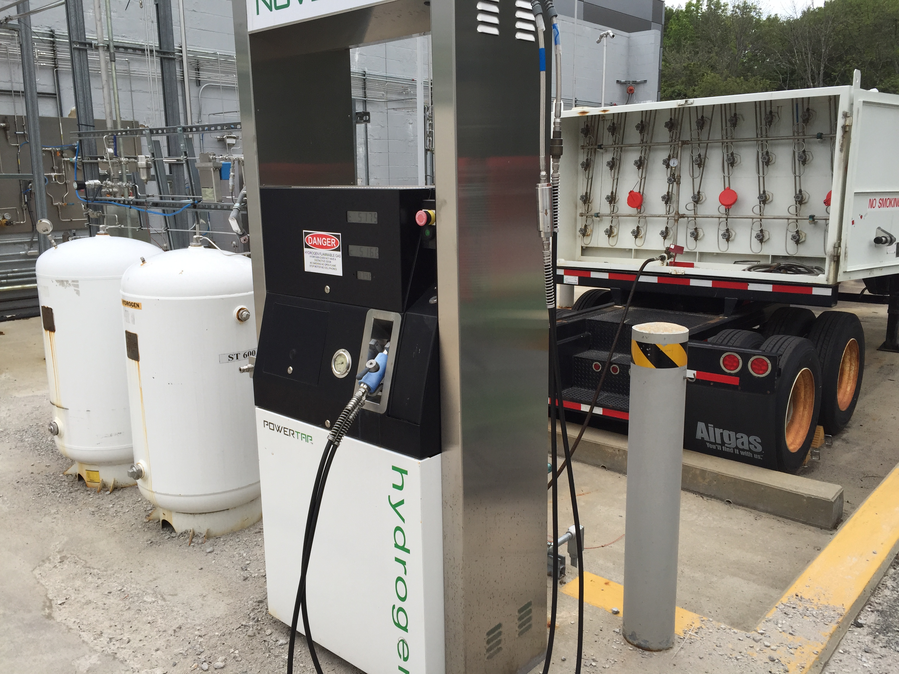
How to get Hydrogen Approved Nuvera Fuel Cell Facility in Billerica, MA
Addressing the concerns
Code compliance and third-party certified systems whenever possible
Due diligence by a hydrogen system expert not directly employed by the system manufacturer
Show a systemic approach to system design and safety incorporation
Hazard handling plan with emergency response

Slide 5
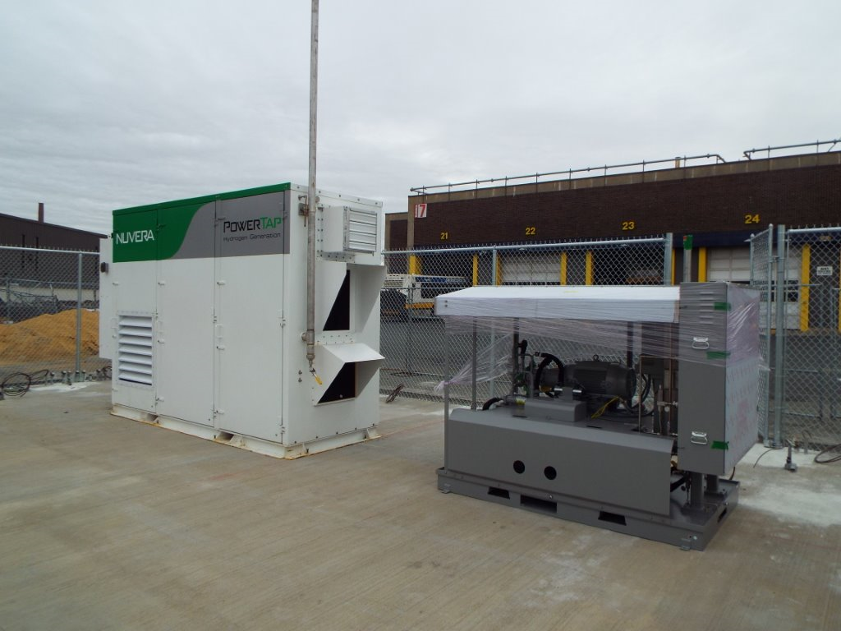
The Hazard Plan and Emergency Response
Hazard plan will answer the following:
How much hydrogen, where is it stored and what form?
Where are the safety detectors and what type are they?
Where are the e-stops, what do they do?
Emergency Response
Actual people and phone numbers
How to shutdown safely
Update the plan on an annual basis

Slide 6
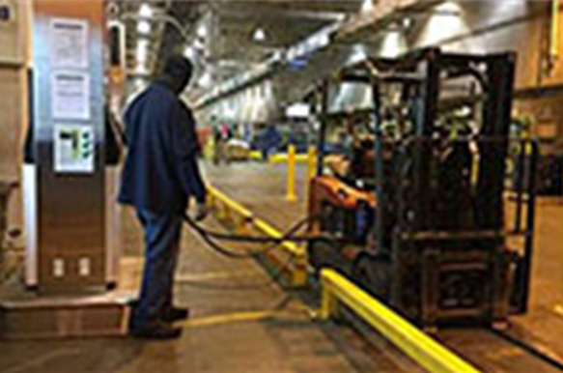
Key take-aways from the process
Early engagement is key
Get out in front of the “Hydrogen Issue” on your project as early as possible.
Provide success stories of installations that have years of trouble-free operation.
Stress the deliberate, thoughtful process that leads to the decision to use hydrogen as the delivery method of the end-use energy.
Do the paperwork to document the hazard and have a plan of what to do in an emergency.
Invite the 1st responders to walk the project with you after completion, get them familiar with your equipment and its layout.

Slide 7
Q&A

Slide 8
Thank You!
Jeremy Smith, P.E.

