Slide 2
Advantages of Point Cloud Mapping and 3D BIM Modeling
Shane Helm, PE
Marc Sano, PE, CEM

Slide 3
Overview
Definitions
Point cloud mapping (laser scanning)
3D BIM modeling
Applications for point cloud mapping
Typical questions about point cloud mapping
Advantages of implementing point cloud mapping during either the design or construction phase
Issues associated with point cloud mapping (laser scanning)
Integration of a point cloud map in the BIM model
Coordination advantages for final project turnover
Case studies

Slide 4
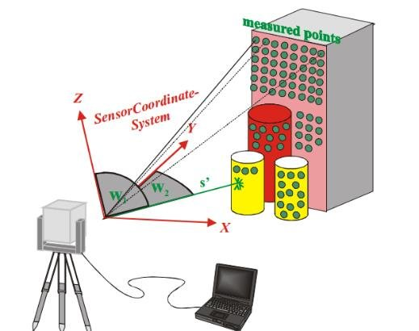
Point Cloud Mapping (Laser Scanning)
A LIDAR (Light Detection & Ranging) scanner emits a laser over an area that is desired to be modeled.
The laser locates a number of points of the modeled object on a coordinate plane. The scanner can be moved around to create more detailed models.
A point cloud model can be created from one or several scans. This model can be imported into CAD/BIM software for coordination by the design/construction team.
Image Source: Khomsin, Khomsin & Pratomo, Danar & Anjasmara, Ira & Ahmad, Faizzuddin. (2019). ANALYSIS OF THE VOLUME COMPARATION OF 3’S (TS, GNSS and TLS). E3S Web of Conferences. 94. 01014. 10.1051/e3sconf/20199401014.

Slide 5
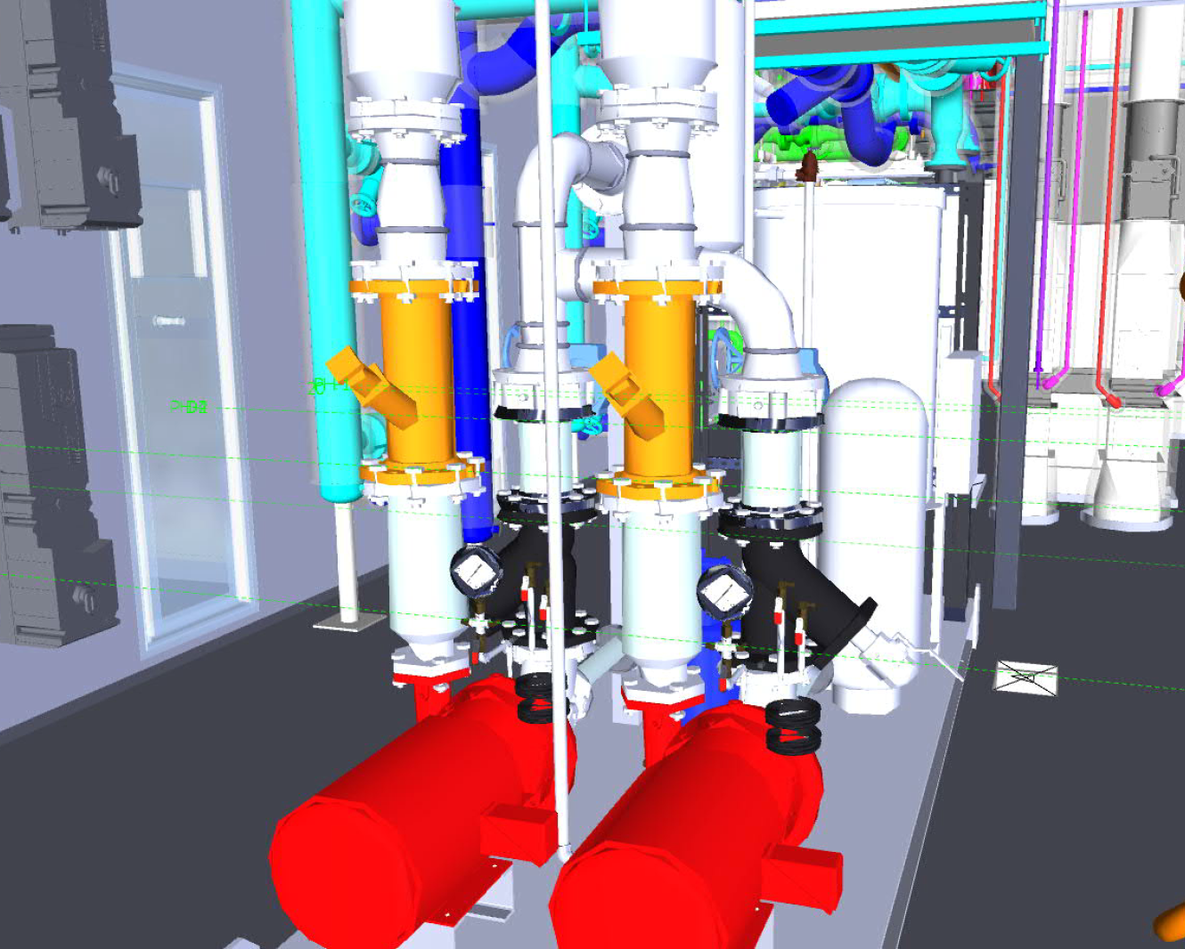
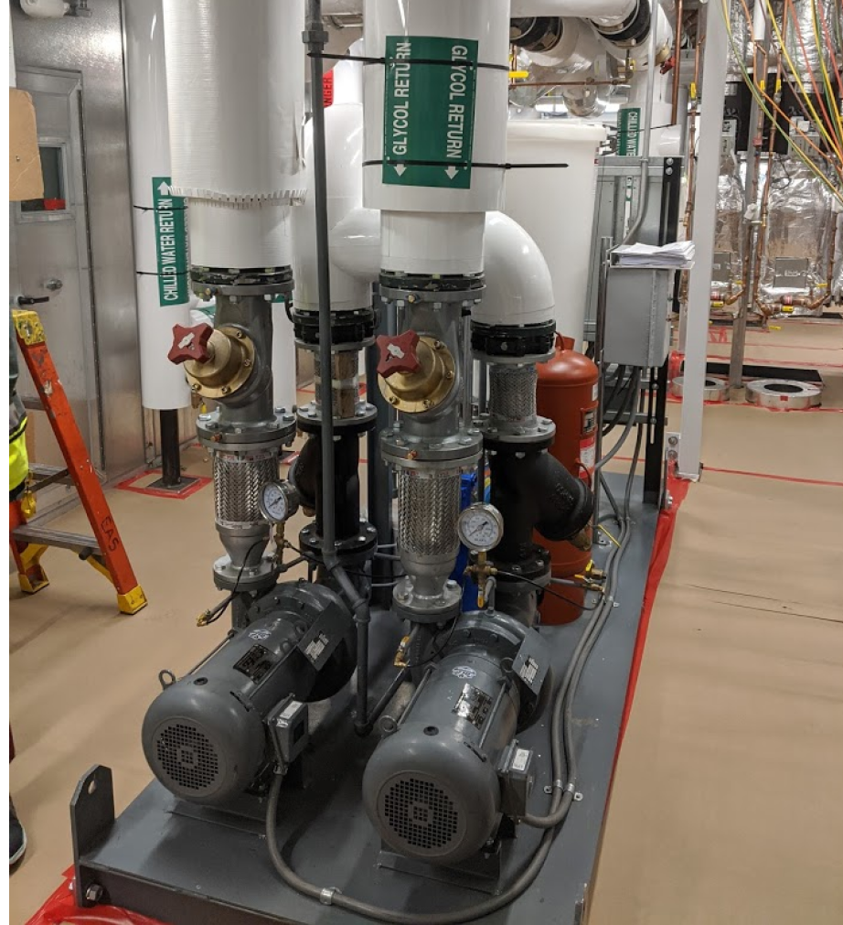
Building Information Modeling (BIM)
ISO 19650-1:2018 defines BIM as: Use of a shared digital representation of a built asset to facilitate design, construction and operation processes to form a reliable basis for decisions.
The US National Building Information Model Standard Project Committee has the following definition: Building Information Modeling (BIM) is a digital representation of physical and functional characteristics of a facility. A BIM is a shared knowledge resource for information about a facility forming a reliable basis for decisions during its life-cycle; defined as existing from earliest conception to demolition.

Slide 6
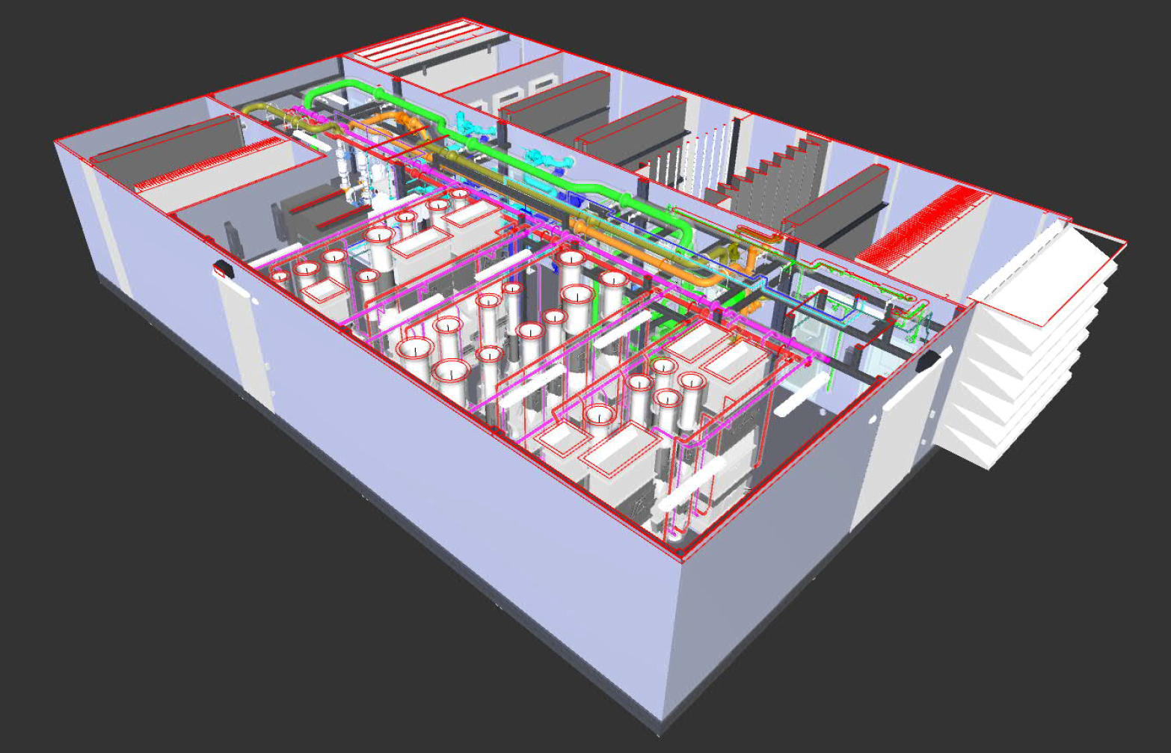
Applications for Point Cloud Mapping (Laser Scanning)
Complex existing piping and ductwork layouts requiring high levels of coordination with new work.
Accessibility is a key driver of design.
Construction must occur during a short shutdown window and must be done correct the first time.
Project is under a tight budget, and costly mistakes must be avoided.

Slide 7
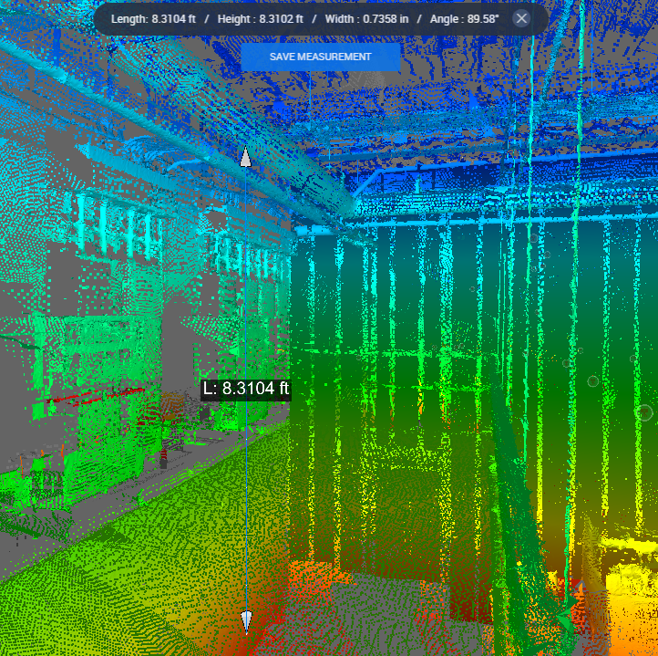
Typical Questions - Point Cloud Mapping (Laser Scanning)
Is it accurate?
New technology is accurate to within 1/32 of an inch
Improved accuracy when multiple scanning locations are combined
Manual survey required?
May eliminate need for manual survey while saving time
Measurements can be taken directly from point cloud map without the need to revisit the survey site if information is missed
Limitations of point cloud mapping?
Reflective surfaces can impact the accuracy
Smaller objects may not be clear in scan if digital noise exists (i.e., ½” piping or conduit)
All components need to be visible to scanner location
Cost?
Typical cost for point cloud mapping is comparable to the cost associated with manual survey of the project area
Added cost to have point cloud converted into a BIM model (not required)

Slide 8
Point Cloud Mapping Implemented During Design
Reduces site survey time and limits additional site surveys as the point cloud scan will contain all information on existing conditions
Design will be based on highly accurate existing conditions
Eliminates risk of inaccurate record drawings (if record drawings exist)
Eliminates risk of inaccessible or elevated working conditions during survey to document accurate existing conditions
Reduces the chances of change orders or redesign once construction begins
Costs associated with actual conditions will be included in contractor bid packages
Allows for coordination with existing equipment or components that are to remain (clearance requirements, maintenance access, etc.)
Notes:
Quick site survey: Point cloud is the fastest way to survey an existing structure at a site. All you need is the point cloud data that has been gathered by a scan; additional or frequent site visits for more data are usually not required.
Optimize time: One of the most apparent benefits of point cloud is that it reduces the amount of time that needs to be spent at the site. It also limits your site visits as you have all the information with you on the point cloud scan. Hence, you do not waste time going back to the site repeatedly.
High accuracy: LiDAR point cloud scans are known for their accuracy. You do not need to recheck whether you have the right coordinates.
Information at hand: You get comprehensive information regarding the existing structure. This reduces the RFI and prevents work delays.
Dimensions: Point cloud scans are effective for measuring dimensions. It also helps you to understand the spatial relation between the different parts of the structure.
Safety: Manual surveys might involve moving through harsh or awkward terrains, which could pose a risk for surveyors and other workers. Point cloud modeling uses drones for data capture, hence minimizing such risks.
Reduce costs: Since point cloud optimizes data and accuracy and reduces time, this translates to lowered costs.
Informed decisions: Point cloud modeling enables your team to make informed decisions based on accurate information.

Slide 9
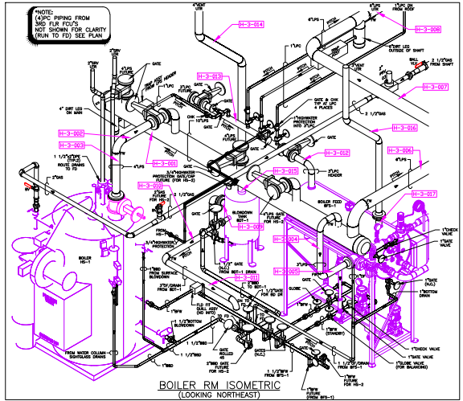
Point Cloud Mapping Implemented During Construction
Shop drawings and contractor coordination will be based on highly accurate existing conditions
Reduces time for shop drawing creation in congested areas
Allows for coordination with existing equipment or components that are to remain (clearance requirements, maintenance access, etc.)
Changes may be required to be made by contractor to meet requirements versus project design drawings
Notes:
Added cost to project to perform point cloud mapping

Slide 10
Issues with Point Cloud Mapping (Laser Scanning)
Access to the entire project area is required to allow for a complete model
Line of sight required to accurately show all objects
Objects hidden from scanner will not be visible unless additional scans from multiple angles are completed
Complexity of project area determines the quantity of scans required to be completed
Lighting levels can impact the detail of the point cloud creating a grainy image with increased signal noise
Manual survey will be required to determine pipe, duct, equipment, etc. sizes if insulated when reliable record drawings do not exist

Slide 11
Integration of Point Cloud Mapping and 3D BIM Model
Allows for accurate existing conditions to be shown in the design or contractor coordination model
Clash detection can be utilized to determine if any conflicts exist with existing conditions
Items/components in the point cloud can be set as demolished eliminating inaccurate conflicts in the clash report
Integration can be completed during the design or as part of the shop drawing development
Notes:
Large file sizes can slow down the BIM Model
Added cost to project to perform point cloud mapping

Slide 12
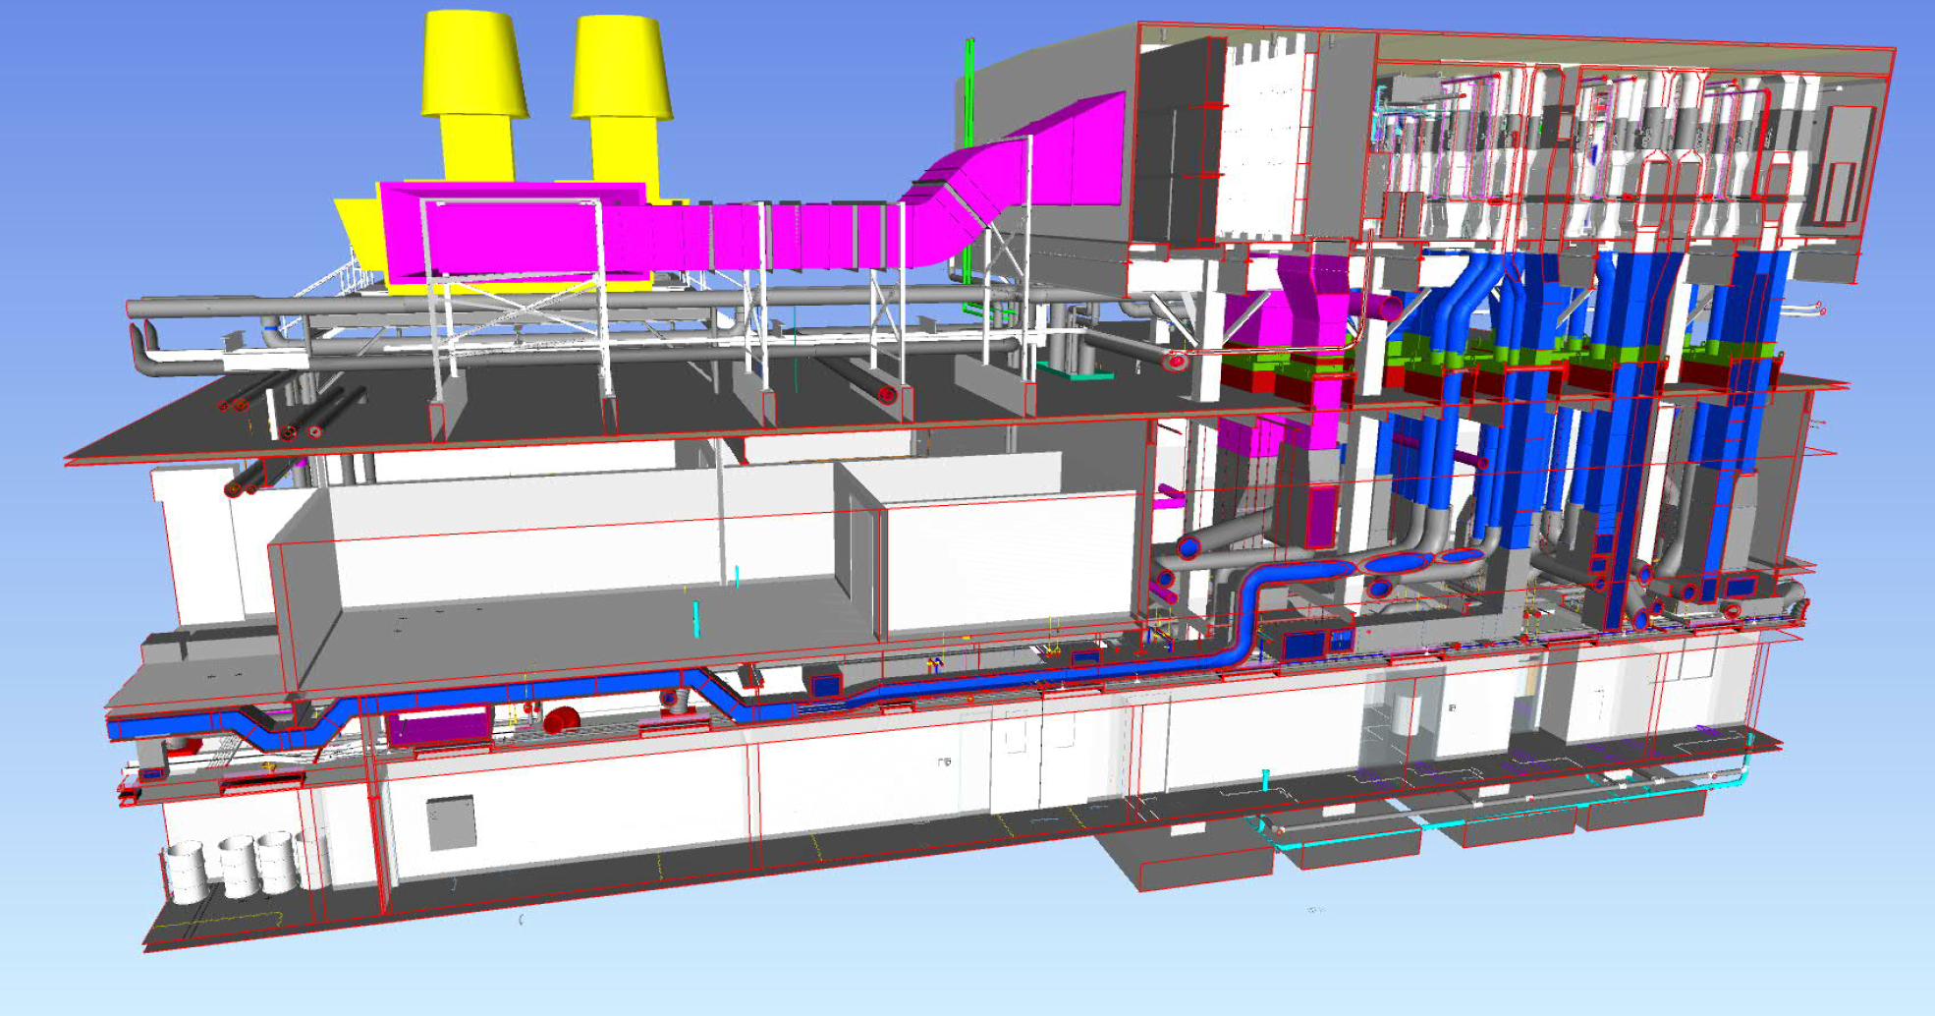
Coordination – Contractor Installation
Streamlines coordination efforts between multiple trades and the existing conditions
Clash detection will include all existing conditions that are to remain
Reduces upfront schedule to complete a full survey by the contractor to determine existing conditions allowing for a quicker turnaround on shop drawings

Slide 13
Coordination - Owner
Ability to verify installation locations for all equipment or components that require routine maintenance are acceptable to owner
Allows for virtual walkthrough to be completed prior to installation
Modifications can be made to layout based on owner review
Identify all valves that require chainwheels if unable to locate below 6’-0”
Verify access via ladder and or lift if required for equipment or components
Scan can be completed as part of project turnover to document the as-built conditions

Slide 14
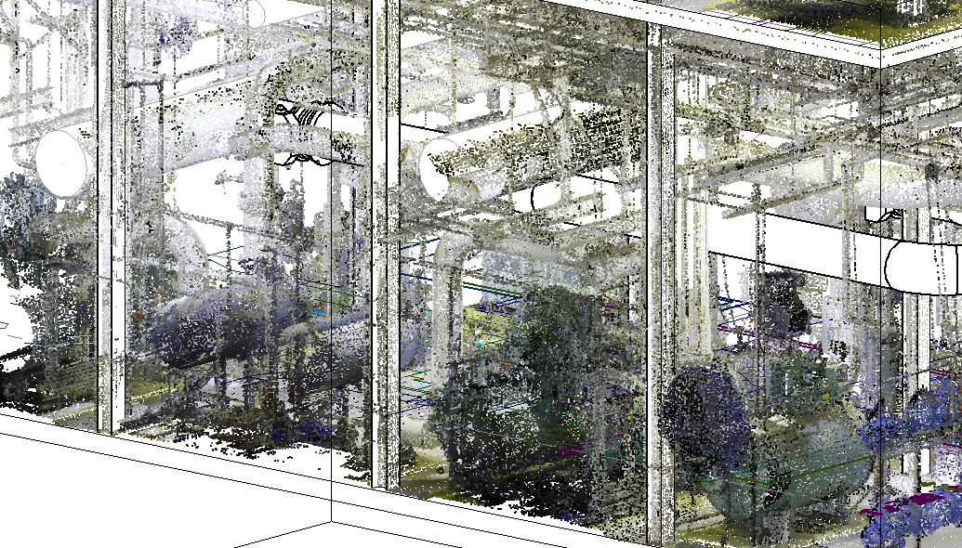
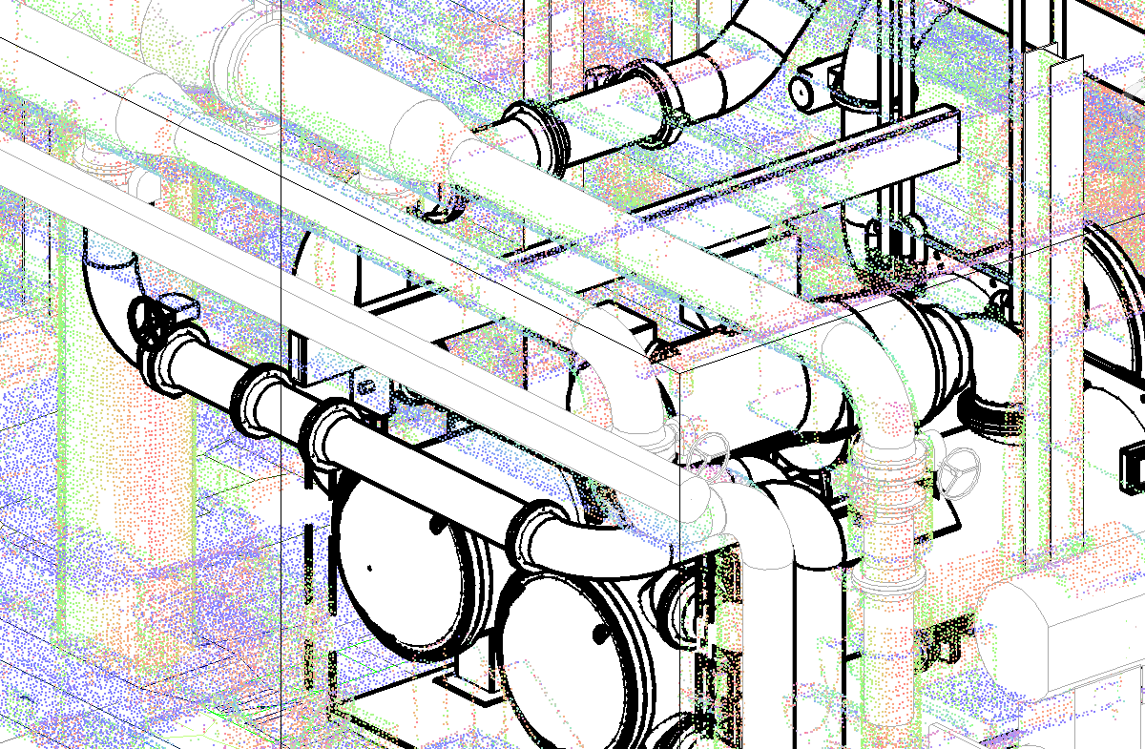
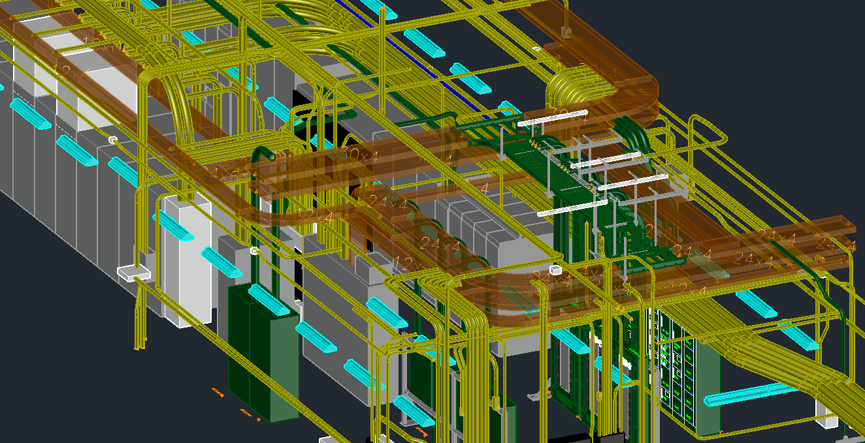
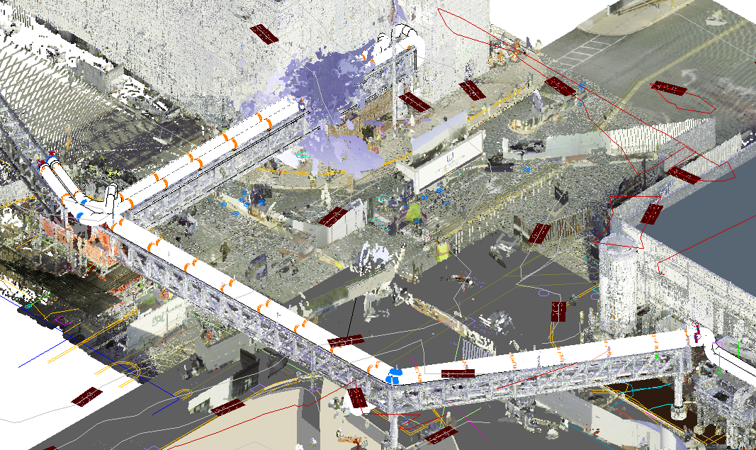
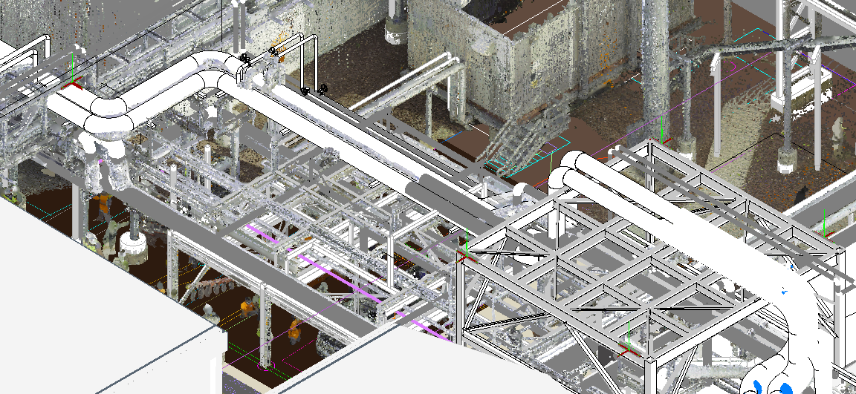
Case Study – SE PA Pharmaceutical Company – Utility Rack & Chiller Installation
Figure – Point Cloud Map Chiller Plant 1st Floor – 30” CHWS Pipe Connection to Existing Coordination
Figure – Point Cloud Map Chiller Plant 2nd Floor – 2,000-ton Chiller & Hoist Beam Installation Coordination
Figure – Point Cloud Map Electrical Room – New Medium Voltage Chiller Feed
Figures – Point Cloud Map Utility Rack– Coordination of New CHWS/R, HPS, and PC Piping on Existing/New Utility Rack

Slide 15
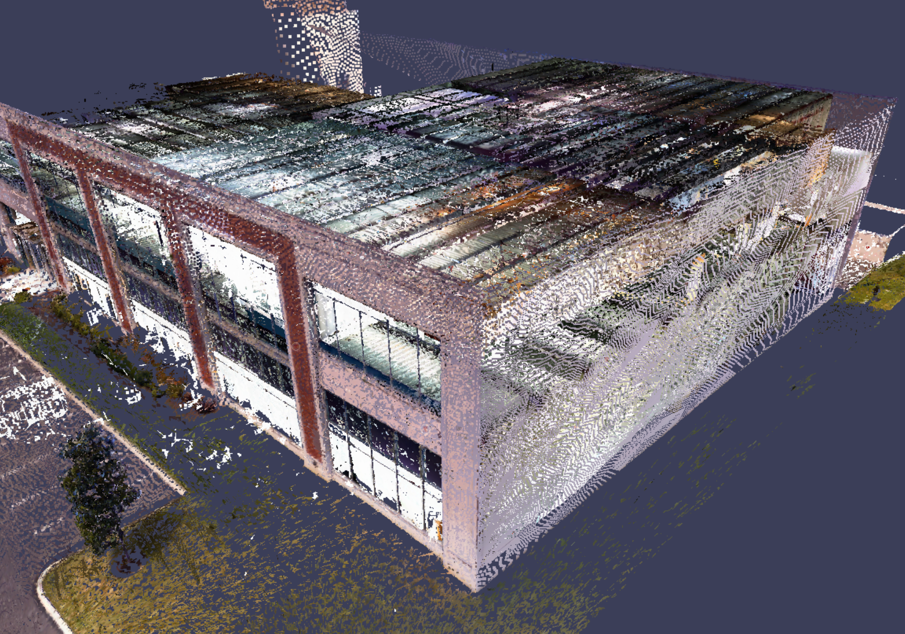
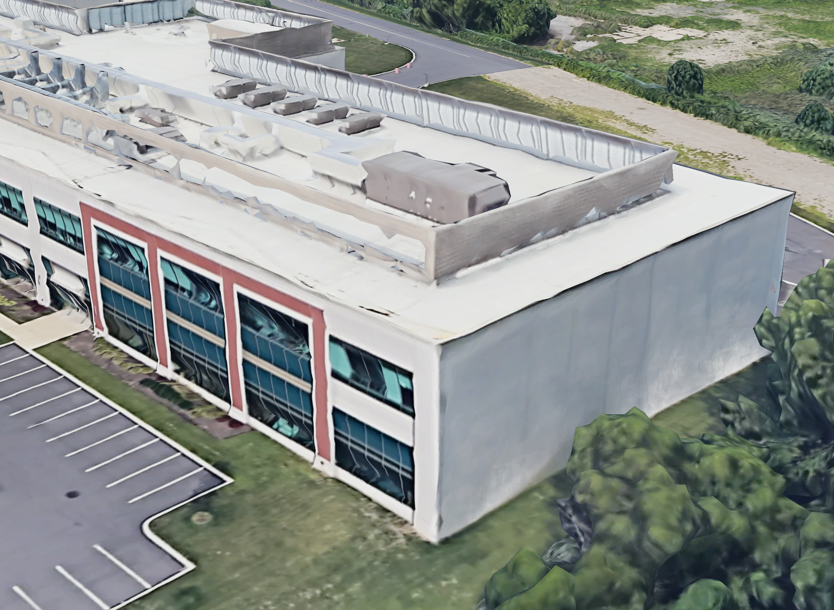
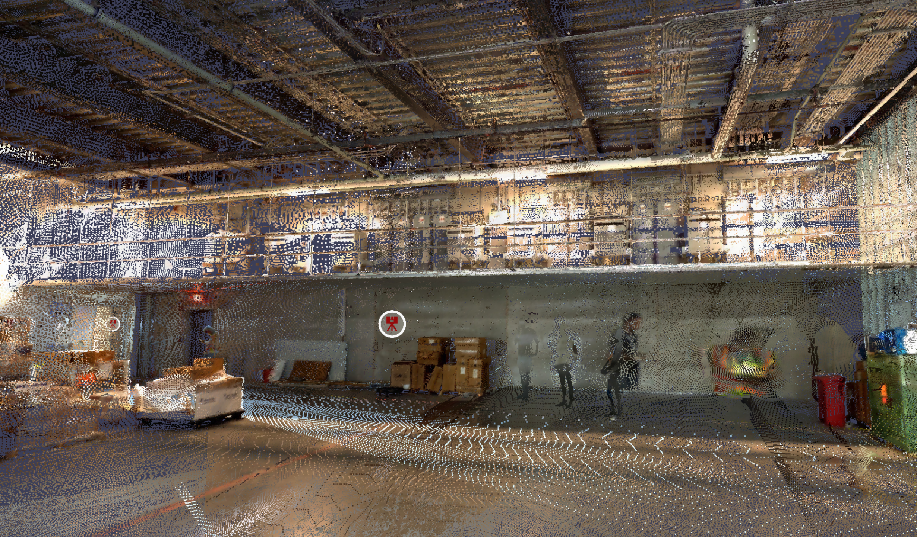
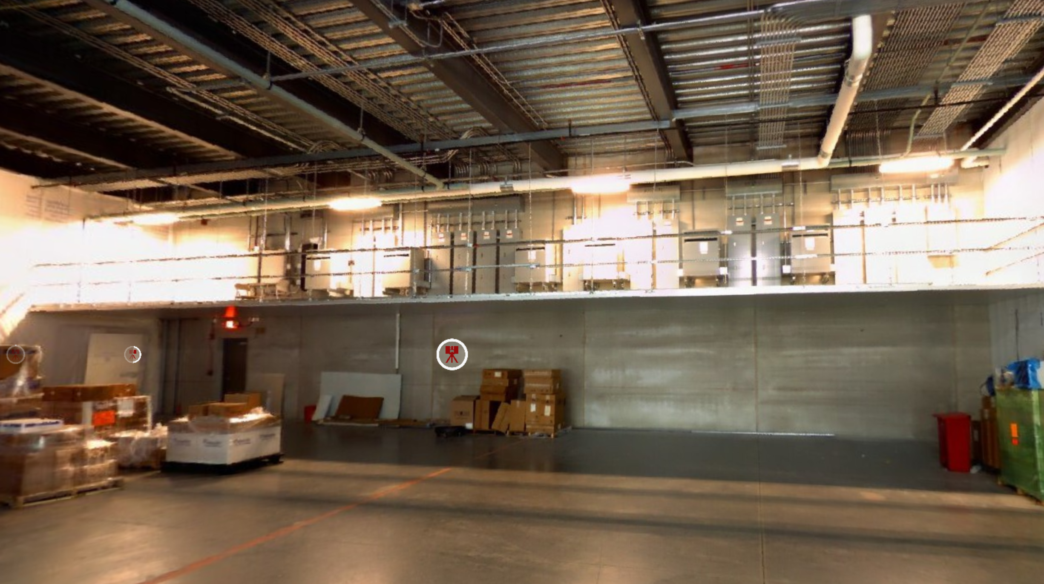
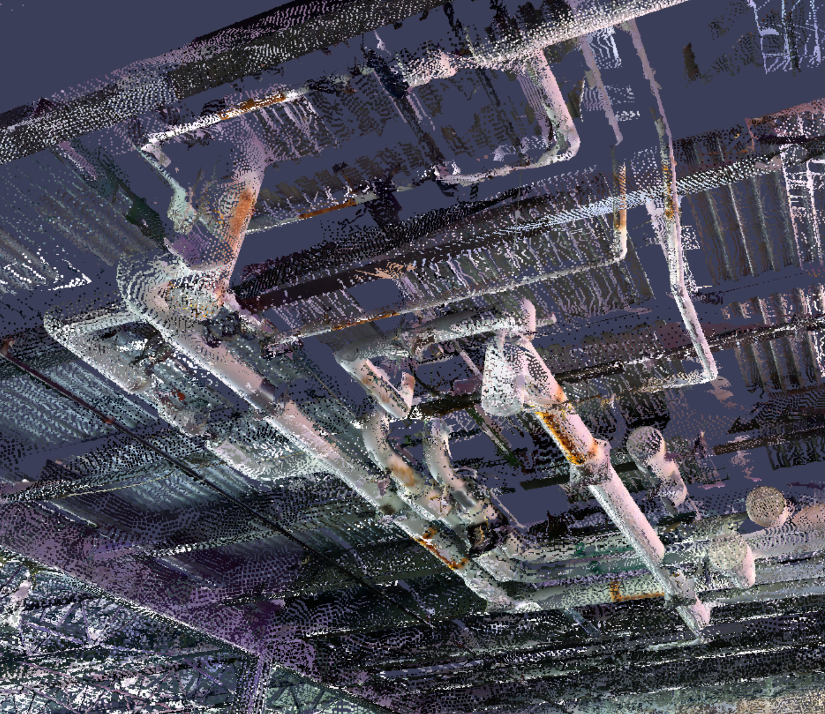
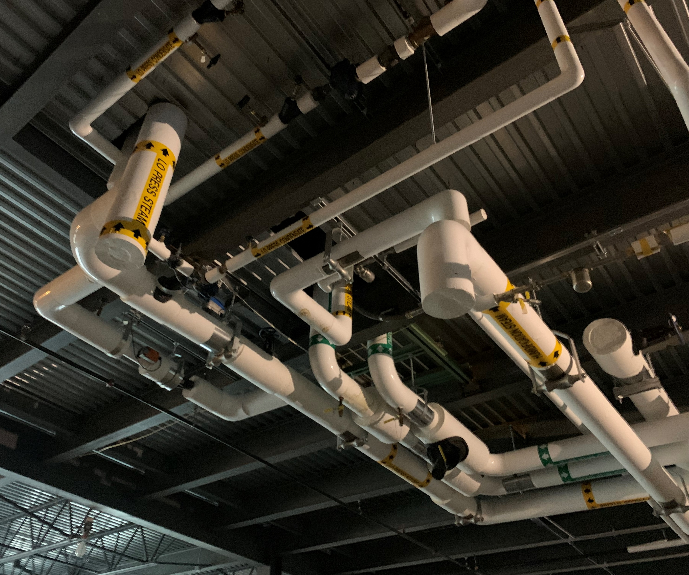
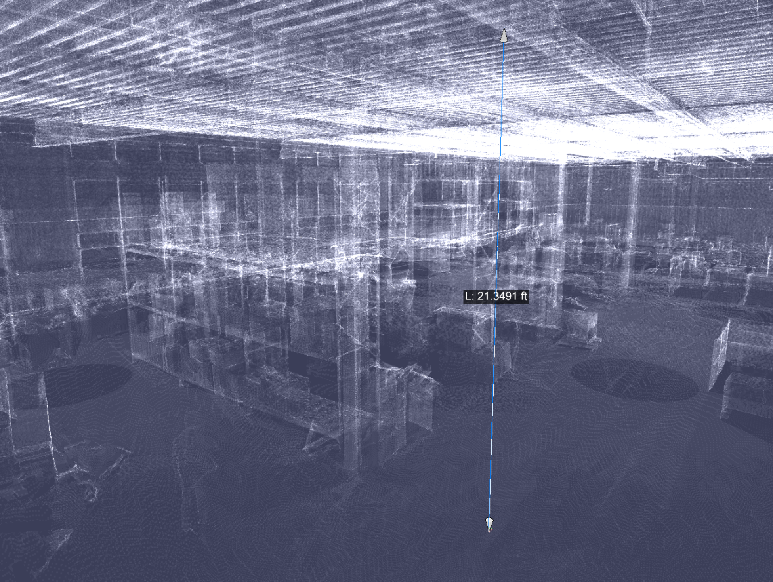
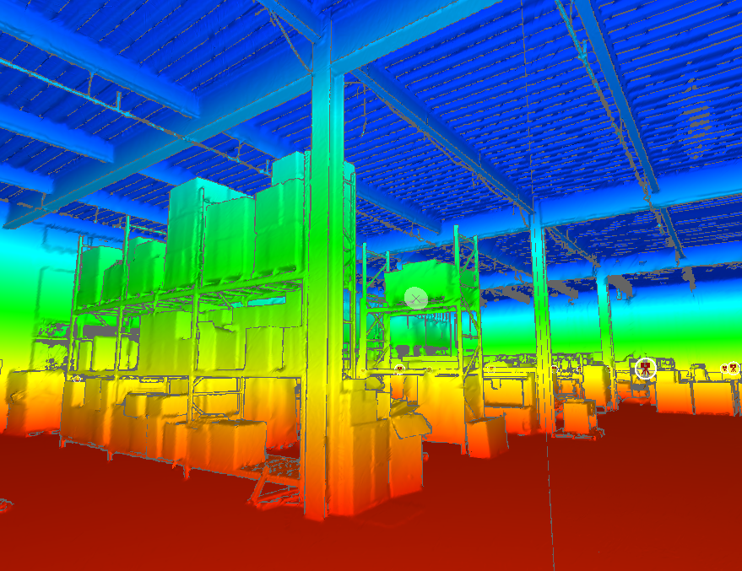
Case Study – Philadelphia Pharmaceutical Company – Fit-out
Figure – Building Exterior - Laser Scan (Left) and Google Earth Image (Right)
Figure – Electrical Panels on Walkable Ceiling - Laser Scan (Left) and Photograph (Right)
Figure – Chilled Water Piping - Laser Scan (Left) and Photograph (Right)
Figure –Shell Space – Point Cloud (Left) and 3D Heightmap View (Right)

Slide 16
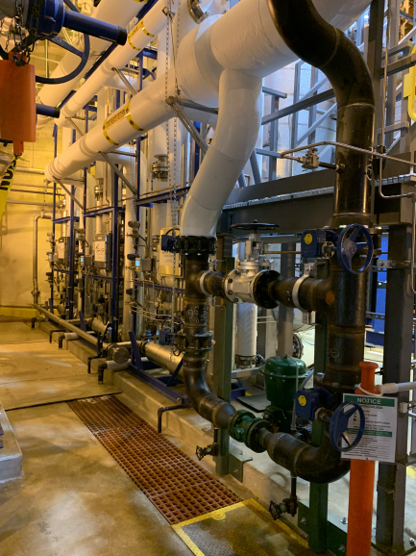
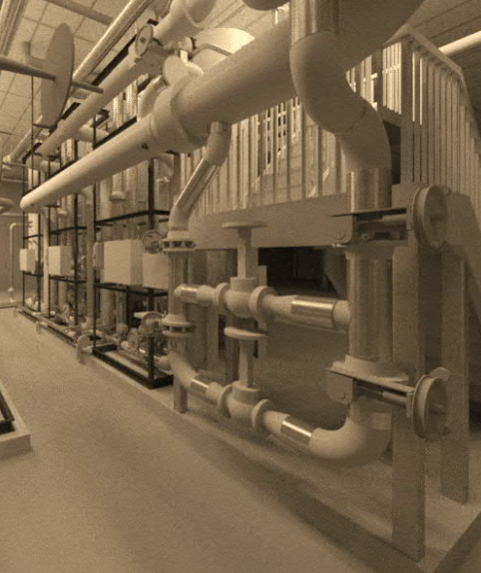
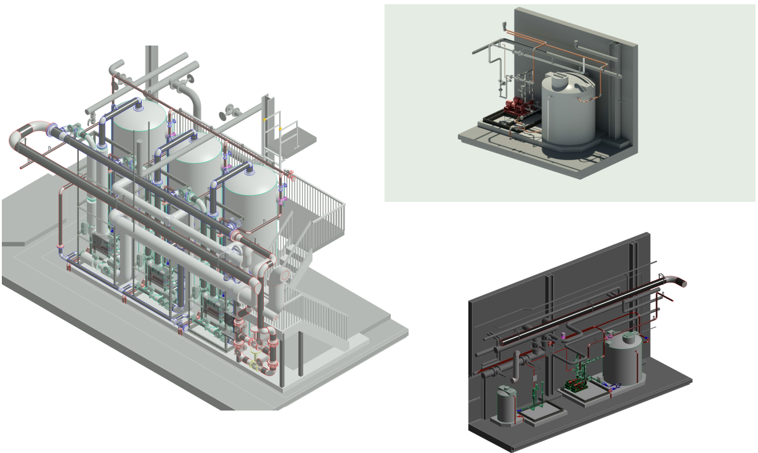
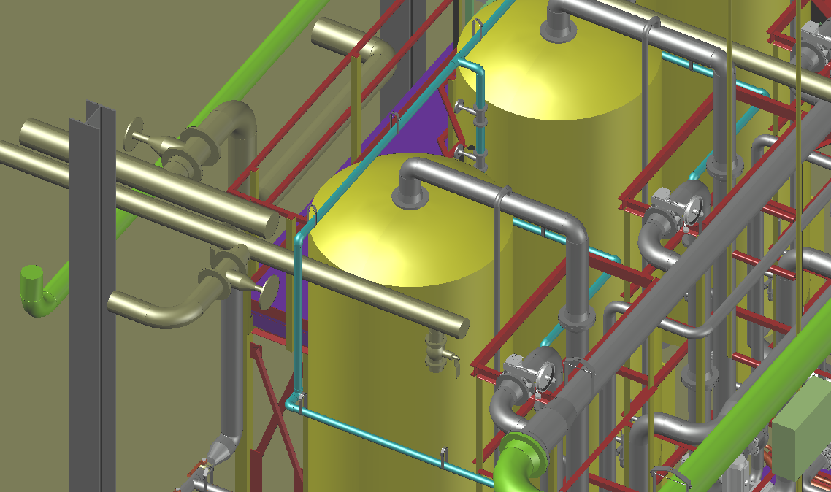
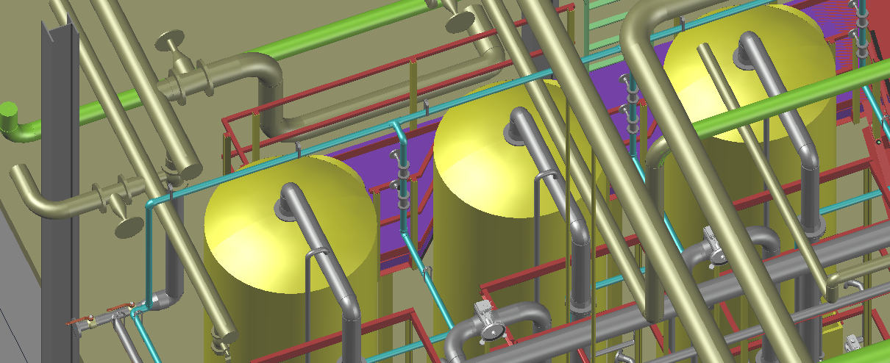
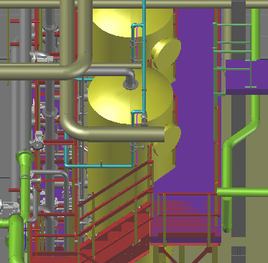
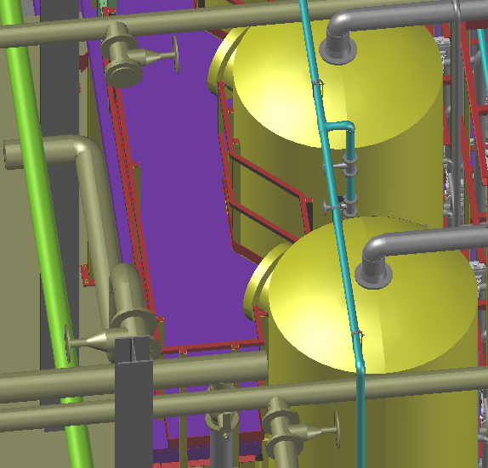
Case Study – SE PA Pharmaceutical Company –
Condensate Polisher
Figures – BIM Model and Final Installation
Figures – BIM Model - Final Design
Figures – Coordination with Existing Conditions (from Point Cloud Map)
Figures – Coordination with Existing Conditions (from Point Cloud Map)
Notes:
Allowed for coordination with existing conditions of less than 1”. Coordinate railing to be installed on inside of steel for platform as needed to coordinate with existing piping.
Allowed for walk through to coordinate that all control valves, instruments were accessible. Identified valves that required chainwheels and allowed for a fully coordinated platform prior to contractor being onboarded.

Slide 17
Thank You!
Shane Helm, PE
Marc Sano, PE, CEM

